Slide 1
Review of Secret Key (Symmetric) Cryptography
Confidentiality
  stream ciphers (uses PRNG)
  block ciphers with encryption modes
Integrity
  Cryptographic hash functions
  Message authentication code (keyed hash functions)
Limitation: sender and receiver must share the same key
  Needs secure channel for key distribution
  Impossible for two parties having no prior relationship
  Needs many keys for n parties to communicate
Fall 2010/Lecture 31

Slide 2
Public Key Encryption Overview
Each party has a PAIR (K, K⁻¹) of keys:
  K is the public key, and used for encryption
  K⁻¹ is the private key, and used for decryption
  Satisfies D_{K}-1[E_{K}[M]] = M
Knowing the public-key K, it is computationally infeasible to compute the private key K⁻¹
  How to check (K,K⁻¹) is a pair?
  Offers only computational security. PK Encryption impossible when P=NP, as deriving K⁻¹ from K is in NP.
The public-key K may be made publicly available, e.g., in a publicly available directory
  Many can encrypt, only one can decrypt
Public-key systems aka asymmetric crypto systems
Fall 2010/Lecture 31

Slide 3
Public Key Encryption Algorithms
Almost all public-key encryption algorithms use either number theory and modular arithmetic, or elliptic curves
RSA
  based on the hardness of factoring large numbers
El Gamal
  Based on the hardness of solving discrete logarithm
  Basic idea: public key g^{x}, private key x, to encrypt: [g^{y}, g^{xy} M].
Fall 2010/Lecture 31

Slide 4
RSA Algorithm
Invented in 1978 by Ron Rivest, Adi Shamir and Leonard Adleman
  Published as R L Rivest, A Shamir, L Adleman, "On Digital Signatures and Public Key Cryptosystems", Communications of the ACM, vol 21 no 2, pp120-126, Feb 1978
Security relies on the difficulty of factoring large composite numbers
Essentially the same algorithm was discovered in 1973 by Clifford Cocks, who works for the British intelligence
Fall 2010/Lecture 31

Slide 5
RSA Public Key Crypto System
Key generation:
1. Select 2 large prime numbers of about the same size, p and q
  Typically each p, q has between 512 and 2048 bits
2. Compute n = pq, and Φ(n) = (q-1)(p-1)
3. Select e, 1<e< Φ(n), s.t. gcd(e, Φ(n)) = 1
  Typically e=3 or e=65537
4. Compute d, 1< d< Φ(n) s.t. ed ≡ 1 mod Φ(n)
  Knowing Φ(n), d easy to compute.
Public key: (e, n)
Private key: d
Fall 2010/Lecture 31

Slide 6
RSA Description (cont.)
Encryption
Given a message M, 0 < M < n M ∈ Z_{n}− {0}
use public key (e, n)
compute C = Me mod n C ∈ Z_{n}− {0}
Decryption
Given a ciphertext C, use private key (d)
Compute C^{d} mod n = (Me mod n)^{d} mod n = M^{ed} mod n = M
Fall 2010/Lecture 31

Slide 7
C = Me mod (n=pq)
Plaintext: M
Ciphertext: C
C^{d} mod n
From n, difficult to figure out p,q
From (n,e), difficult to figure d.
From (n,e) and C, difficult to figure out M s.t. C = Me
Fall 2010/Lecture 31

Slide 8
RSA Example
p = 11, q = 7, n = 77, Φ(n) = 60
d = 13, e = 37 (ed = 481; ed mod 60 = 1)
Let M = 15. Then C ≡ Me mod n
  C ≡ 15³⁷ (mod 77) = 71
M ≡ C^{d} mod n
  M ≡ 71¹³ (mod 77) = 15
Fall 2010/Lecture 31

Slide 9
RSA Example 2
Parameters:
  p = 3, q = 5, q= pq = 15
  Φ(n) = ?
Let e = 3, what is d?
Given M=2, what is C?
How to decrypt?
Fall 2010/Lecture 31

Slide 10
RSA Security
Security depends on the difficulty of factoring n
  Factor n => Φ(n) => compute d from (e, Φ(n))
The length of n=pq reflects the strength
  700-bit n factored in 2007
  768 bit factored in 2009
1024 bit for minimal level of security today
  likely to be breakable in near future
Minimal 2048 bits recommended for current usage
NIST suggests 15360-bit RSA keys are equivalent in strength to 256-bit
RSA speed is quadratic in key length
Fall 2010/Lecture 31

Slide 11
Real World Usage of Public Key Encryption
Often used to encrypt a symmetric key
  To encrypt a message M under a public key (n,e), generate a new AES key K, compute [RSA(n,e,K), AES(K,M)]
Plain RSA does not satisfy IND requirement.
  How to break it?
One often needs padding, e.g., Optimal Asymmetric Encryption Padding (OAEP)
  Roughly, to encrypt M, chooses random r, encode M as M’ = [X = M ⊕ H₁(r) , Y= r ⊕ H₂(X) ] where H₁ and H₂ are cryptographic hash functions, then encrypt it as (M’) ^{e} mod n
  Note that given M’=[X,Y], r = Y ⊕ H₂(X), and M = X ⊕ H₁(r)
Fall 2010/Lecture 31

Slide 12
Digital Signatures: The Problem
Consider the real-life example where a person pays by credit card and signs a bill; the seller verifies that the signature on the bill is the same with the signature on the card
Contracts, they are valid if they are signed.
Signatures provide non-repudiation.
  ensuring that a party in a dispute cannot repudiate, or refute the validity of a statement or contract.
Can we have a similar service in the electronic world?
  Does Message Authentication Code provide non-repudiation? Why?
Fall 2010/Lecture 31

Slide 13
Digital Signatures
MAC: One party generates MAC, one party verifies integrity.
Digital signatures: One party generates signature, many parties can verify.
Digital Signature: a data string which associates a message with some originating entity.
Digital Signature Scheme:
  a signing algorithm: takes a message and a (private) signing key, outputs a signature
  a verification algorithm: takes a (public) key verification key, a message, and a signature
Provides:
  Authentication, Data integrity, Non-Repudiation
Fall 2010/Lecture 31

Slide 14
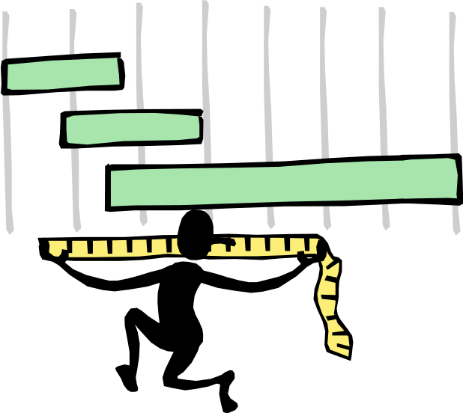
Digital Signatures and Hash
Very often digital signatures are used with hash functions, hash of a message is signed, instead of the message.
Hash function must be:
  Pre-image resistant
  Weak collision resistant
  Strong collision resistant
Fall 2010/Lecture 31

Slide 15
RSA Signatures
Key generation (as in RSA encryption):
Select 2 large prime numbers of about the
same size, p and q
Compute n = pq, and Φ = (q - 1)(p - 1)
Select a random integer e, 1 < e < Φ, s.t.
gcd(e, Φ) = 1
Compute d, 1 < d < Φ s.t. ed ≡ 1 mod Φ
Public key: (e, n) used for verification
Secret key: d, used for generation
Fall 2010/Lecture 31

Slide 16
RSA Signatures (cont.)
Signing message M
Verify 0 < M < n
Compute S = M^{d} mod n
Verifying signature S
Use public key (e, n)
Compute S^{e} mod n = (M^{d} mod n)^{e} mod n = M
Note: in practice, a hash of the message is signed
and not the message itself.
Fall 2010/Lecture 31

Slide 17
The Big Picture
Secrecy / Confidentiality | Stream ciphers Block ciphers + encryption modes | Public key encryption: RSA, El Gamal, etc.
Authenticity / Integrity | Message Authentication Code | Digital Signatures: RSA, DSA, etc.
Secret Key
Setting
Public Key
Setting
Fall 2010/Lecture 31

Slide 18
Fall 2010/Lecture 31

Slide 19

Zero Knowledge Proofs

Slide 20
Interactive Proof Systems
Traditionally, a proof for a statement is a static string such that one can verify for its correctness
  Follows axioms and deduction rules.
Generalizing proof systems to be interactive
  A proof system involves an algorithm for a prover and a verifier.
  A proof system can be probabilistic in ensuring correctness of the statement being proved

Slide 21
Zero Knowledge Proofs
A protocol involving a prover and a verifier that enables the prover to prove to a verifier without revealing any other information
  E.g., proving that a number n is of the form of the product of two prime number
  Proving that one knows p,q such that n=pq
  Proving that one knows x such g^{x} mod p = y
CS555
Topic 23

Slide 22
Two Kinds of Zero-Knowledge Proofs
ZK proof of a statement
  convincing the verifier that a statement is true without yielding any other information
  example of a statement, a propositional formula is satisfiable
ZK proof of knowledge
  convincing the verifier that one knows a secret, e.g., one knows the discrete logarithm log_{g}(y)
CS555
Topic 23

Slide 23
Properties of Interactive Zero-Knowledge Proofs of Knowledge
Completeness
  Given honest prover and honest verifier, the protocol succeeds with overwhelming probability
Soundness
  no one who doesn’t know the secret can convince the verifier with nonnegligible probability
Zero knowledge
  the proof does not leak any additional information
CS555
Topic 23

Slide 24
Honest Verifier ZK vs. Standard ZK
Honest Verifier ZK means that a simulator exists for the Verifier algorithm V given in the protocol.
Standard ZK requires that a simulator exists for any algorithm V* that can play the role of the verifier in the protocol.
CS555
Topic 23

Slide 25
Zero Knowledge Proof of Knowledge
A ZKP protocol is a proof of knowledge if it satisfies a stronger soundness property:
  The prover must know the witness of the statement
Soundness property: If a prover A can convince a verifier, then a knowledge exactor exists
  a polynomial algorithm that given A can output the secret
The Fiat-Shamir protocol is also a proof of knowledge:
CS555
Topic 23

Slide 26
Elliptic Curve
What are Elliptic Curves?
  Curve with standard form y² = x³ + ax + b a, b ϵ ℝ
Characteristics of Elliptic Curve
  Forms an abelian group
  Symmetric about the x-axis
  Point at Infinity acting as the identity element

Slide 27
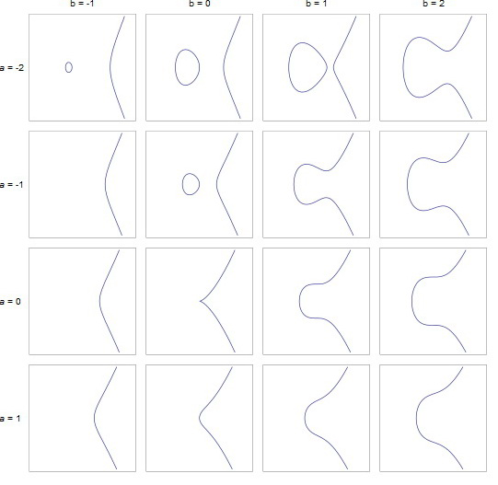
Examples of Elliptic Curves

Slide 28
Why Elliptic Curve Cryptography?
Shorter Key Length
Lesser Computational Complexity
Low Power Requirement
More Secure

Slide 29
Comparable Key Sizes for Equivalent Security
Symmetric Encryption (Key Size in bits) | RSA and Diffie-Hellman (modulus size in bits) | ECC Key Size in bits
56 | 512 | 112
80 | 1024 | 160
112 | 2048 | 224
128 | 3072 | 256
192 | 7680 | 384
256 | 15360 | 512

Slide 30
What is Elliptic Curve Cryptography?
Implementing Group Operations
  Main operations - point addition and point multiplication
  Adding two points that lie on an Elliptic Curve – results in a third point on the curve
  Point multiplication is repeated addition
  If P is a known point on the curve (aka Base point; part of domain parameters) and it is multiplied by a scalar k, Q=kP is the operation of adding P + P + P + P… +P (k times)
  Q is the resulting public key and k is the private key in the public-private key pair

Slide 31
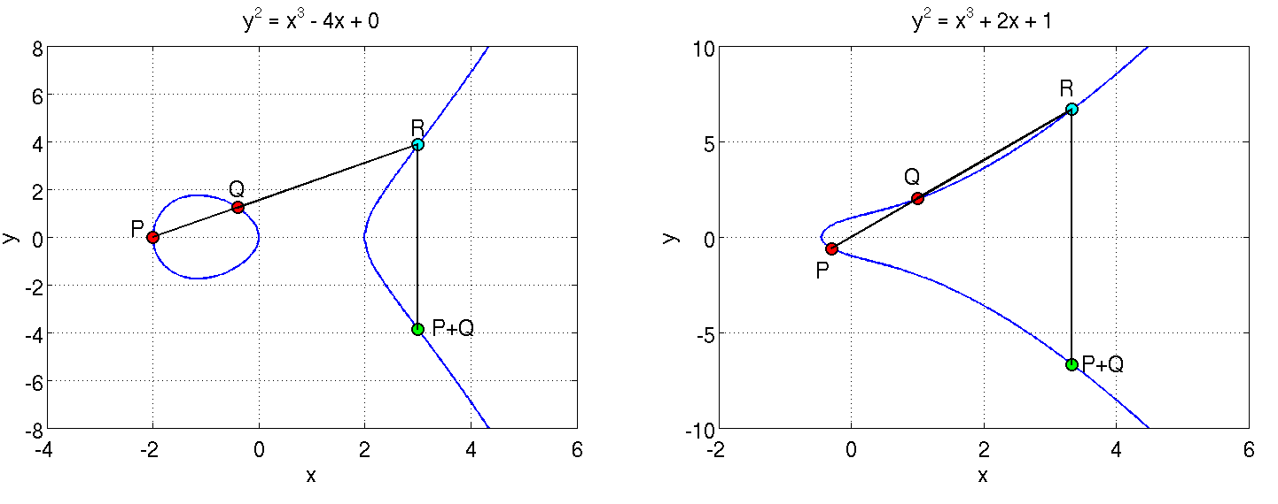
What is Elliptic Curve Cryptography?
Adding two points on the curve
P and Q are added to obtain P+Q which is a reflection of R along the X axis

Slide 32
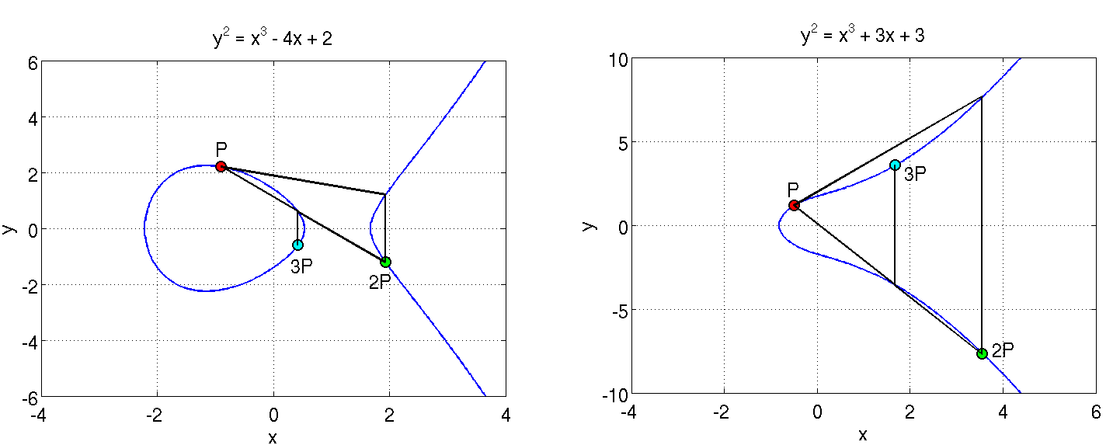
What is Elliptic Curve Cryptography?
A tangent at P is extended to cut the curve at a point; its reflection is 2P
Adding P and 2P gives 3P
Similarly, such operations can be performed as many times as desired to obtain Q = kP

Slide 33
What is Elliptic Curve Cryptography?
Discrete Log Problem
  The security of ECC is due the intractability or difficulty of solving the inverse operation of finding k given Q and P
  This is termed as the discrete log problem
  Methods to solve include brute force and Pollard’s Rho attack both of which are computationally expensive or unfeasible
  The version applicable in ECC is called the Elliptic Curve Discrete Log Problem
  Exponential running time

Slide 34
Elliptic Curve Schemes
Elliptic Curve Digital Signature Algorithm (ECDSA)
Elliptic Curve Pintsov Vanstone Signature(ECPVS)
Elliptic Curve Diffie-Hellman (ECDH)

Slide 35
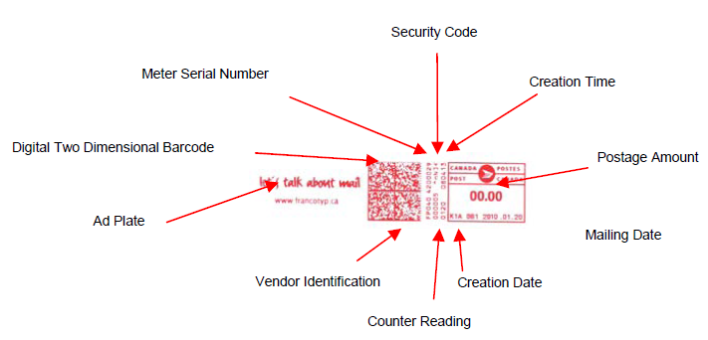
Elliptic Curve Digital Signature Algorithm (ECDSA)
Elliptic curve variant of Digital Signature Algorithm
Canadian postage stamp that uses ECDSA

Slide 36
ECDSA
Signature Generation
Once we have the domain parameters and have decided on the keys to be used, the signature is generated by the following steps.
Given Input: d, G, n, hash Function H
1. A random number k, 1 ≤ k ≤ n-1 is chosen
2. kG = (x₁,y₁) is computed. x₁ is converted to its corresponding integer x₁’
3. Next, r = x₁ mod n is computed. If r=0 go to step 1.
4. We then compute k⁻¹ mod q
5. e = HASH(m) where m is the message to be signed
6. s = k⁻¹(e + dr) mod n. If s=0 then go to step 1.
where d is the private key of the sender.
We have the signature as (r,s)

Slide 37
ECDSA
Signature Verification
Given: (r,s), m,n,e,G, Q, and hash function H
At the receiver’s end the signature is verified as follows:
1. Verify whether r and s belong to the interval [1, n-1] for the signature to be valid.
2. Compute e = HASH(m). The hash function should be the same as the one used for signature generation.
3. Compute w = s⁻¹ mod n.
4. Compute u₁ = ew mod n and u₂ = rw mod n.
5. Compute (x₁,y₁) = u₁G + u₂Q.
6. The signature is valid if r = x₁ mod n, invalid otherwise.
This is how we know that the verification works the way we want it to:
We have, s = k⁻¹(e + dr) mod n which we can rearrange to obtain, k = s⁻¹(e + dr) which is
s⁻¹e + s⁻¹rd
This is nothing but we + wrd = (u₁ + u₂d) (mod n)
We have u₁G + u₂Q = (u₁ + u₂d)G = kG which translates to v = r.

Slide 38
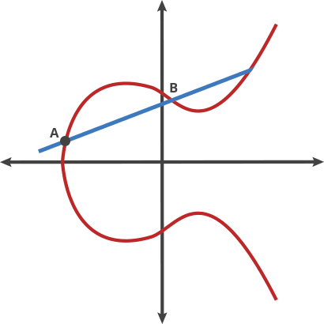
ECDSA
Fall 2010/Lecture 31

